Slide 1
Data Analysis on Medical Insurance
Presented by:
Group-3 Team Members

Slide 2
Table of Contents:
Objective
Analysis on Insurance Cost, Age by region
Analysis on BMI, Age, Children
Smokers’ analysis
Conclusion
Thank you

Slide 3
Objective
Predict medical costs for over 1300 individuals, based on attributes such as age, gender, BMI, how many children they have, if there are any smoker or not.
Identify if there are any relationships on the above factors with the insurance cost and geographic regions.
Source: Medical Insurance Costs (kaggle.com)
https://www.kaggle.com/datasets/joebeachcapital/medical-insurance-costs

Slide 4
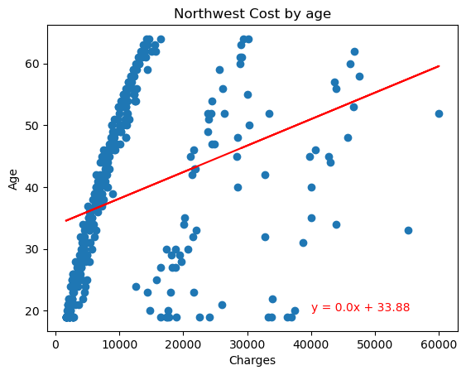
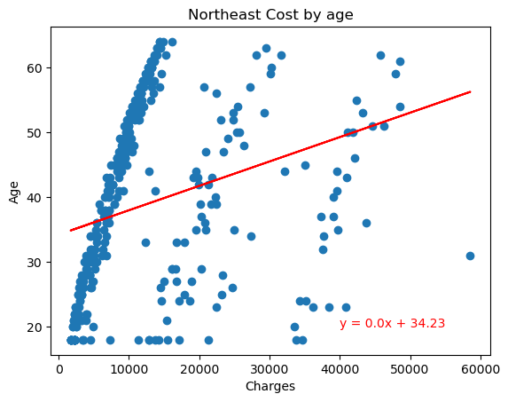
Analysis on Insurance Cost, Age by region

Slide 5
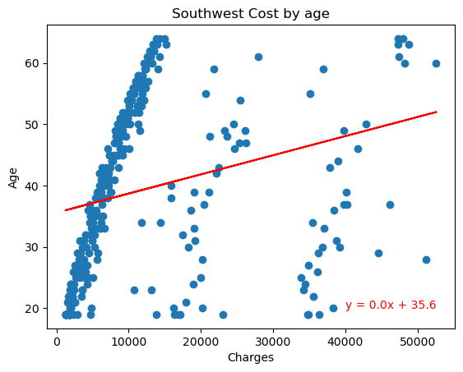
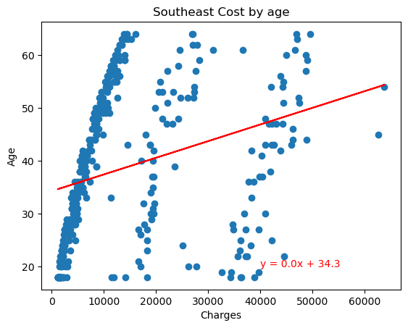
Analysis on Insurance Cost, Age by region Contd…..

Slide 6
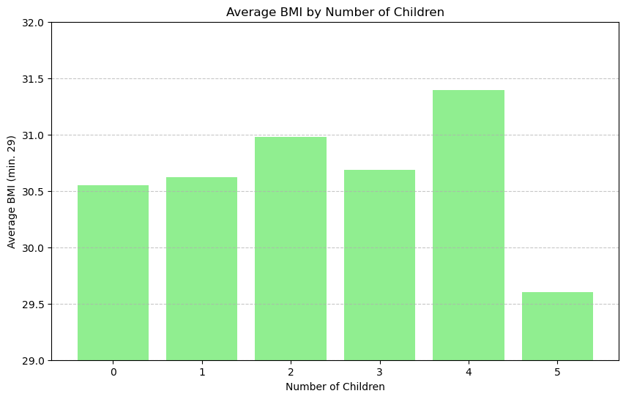
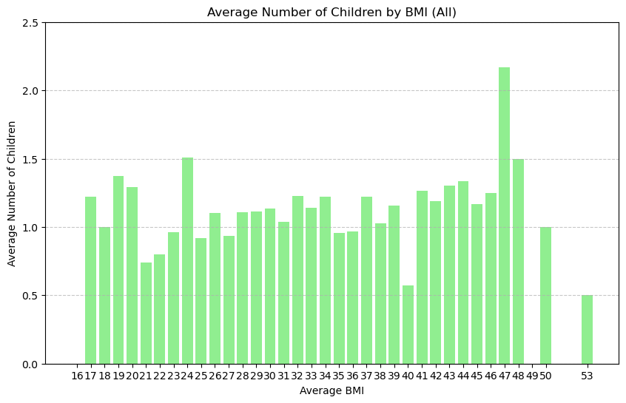
Analysis on BMI, Gender, Children
Is there a relationship between BMI and children?

Slide 7
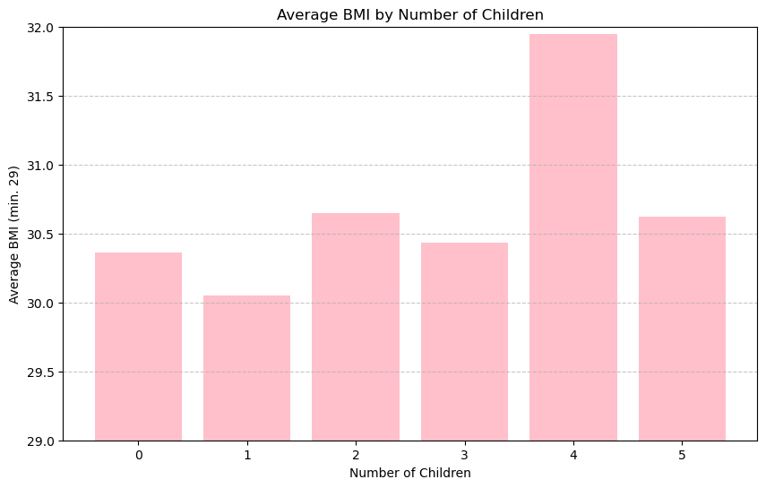
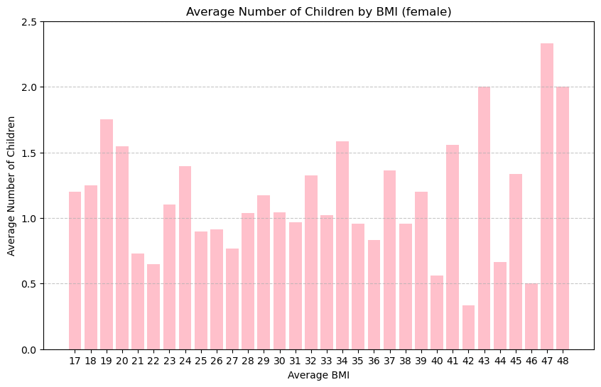
Analysis on BMI, Gender, Children Contd…
Is there a relationship between BMI and children in women?

Slide 8
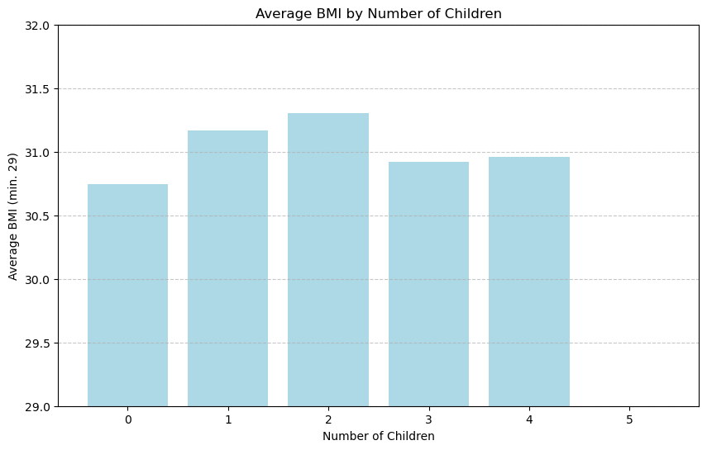
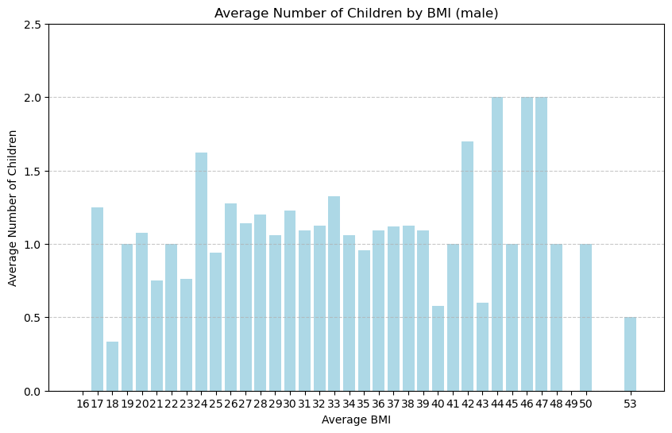
Analysis on BMI, Gender, Children Contd…
Is there a relationship between BMI and children in men?

Slide 9
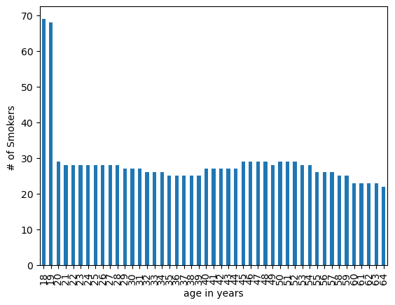
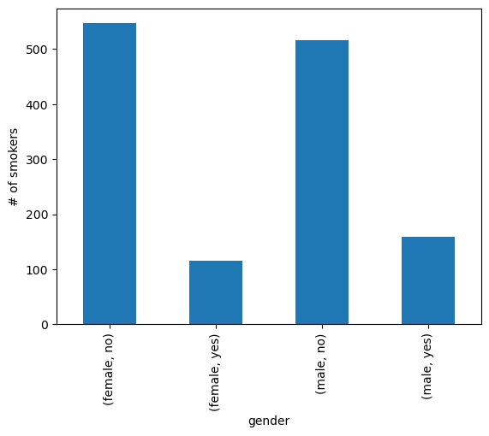
Smokers’ Analysis
Smokers’ by Age analysis
Smokers’ by Gender analysis

Slide 10
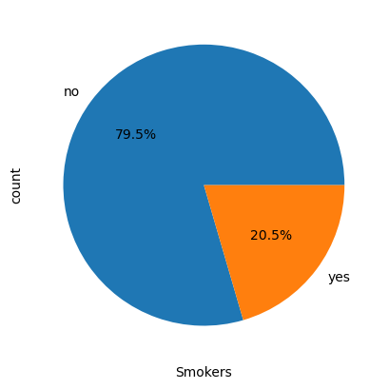
Smokers’ Analysis Contd…
Smokers’ analysis

Slide 11
Conclusion
Analysis on Insurance Cost, Age by region
From the scatter plots of age vs cost per region, it is noticeable how far they are from the linear regression lines so it can be said that there is little to no correlation between age and cost no matter what region an individual is.
Analysis on BMI, Gender and Children No direct correlation was found between BMI and the number of children, whether considering both genders or analyzing women and men separately.
Analysis on Smokers
From the Bar & pie charts of smokers, it is noticeable that 20.5% of the population are smokers and mostly in the age group of 18 and 19 years.

Slide 12
Thank You

